Slide 1

National Institute of Technology,
Calicut, Kerala
Project On
Attendance Management System
Guide
Dr. Sudeep K S
Prepared by-
Sarvesh Singh (M150054CA)

Slide 2
Problem Definition
It’s an android application. This application provides all functionalities
for managing the attendance. There will be three user (Moderator, Teacher, Student) and all user have specific work.

Slide 3
Inputs
Student and Teacher Details
Assign Courses Details
Course Enrollment Details
Take Attendance
Queries and replies made by Users
Outputs
View Courses
Attendance Details
Notification
Toast messages for each action
List of messages

Slide 4
Importance and Motivation
➢ Easy and efficient taking attendance.
➢ Easy to respond student query related to subject.
➢ Provides an easier way to maintain the recorded attendance details.
➢ Application will automatically give notifications to the student.
➢ It will save papers and help to our environment.
➢ Reduces the issues of attendance mistakes between students and teachers.

Slide 5
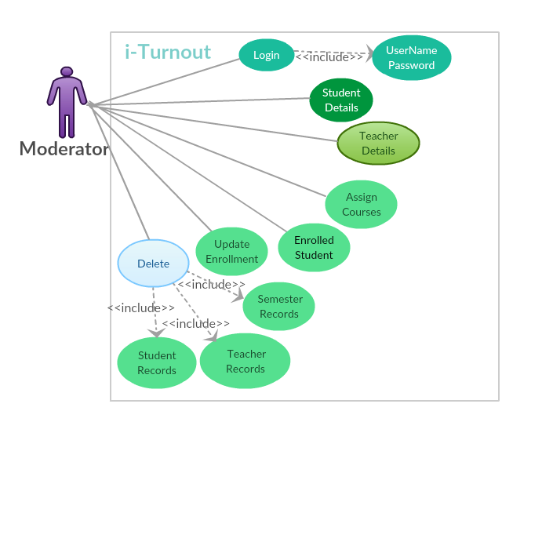
Use Case Diagram For Moderator

Slide 6
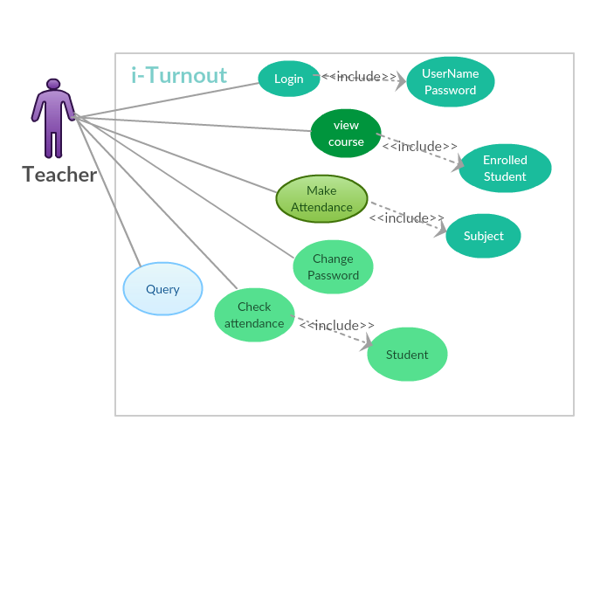
Use Case Diagram For Teacher

Slide 7
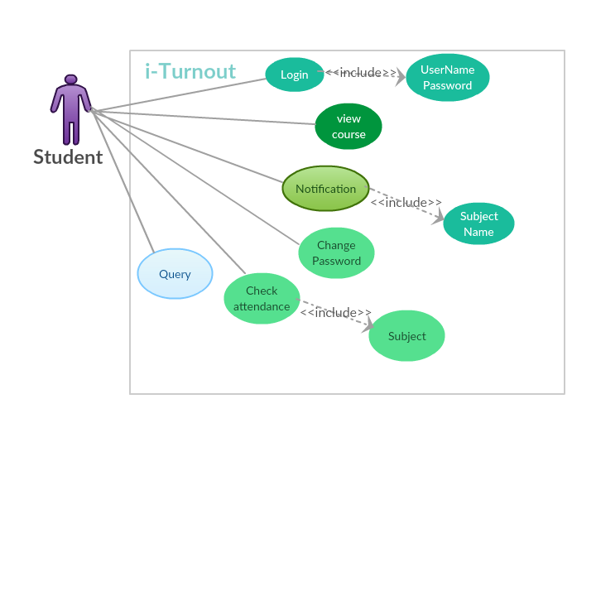
Use Case Diagram For Student

Slide 8
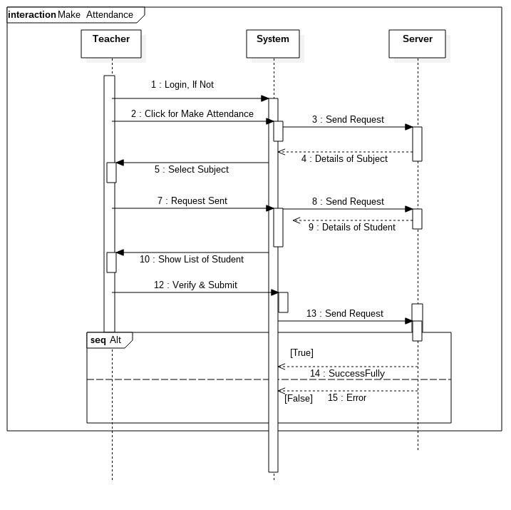
Sequance Diagram for taking attendance

Slide 9
Implementation details
1. Android application using android studio , Java and XML.
2. PHP as Server side language and MySQL as Database
3. Github Link : https://github.com/Singh007sarvesh/iTurnout
4. The whole project has been developed considering three major
modules- Moderator Features,Teacher Features and Student Features

Slide 10
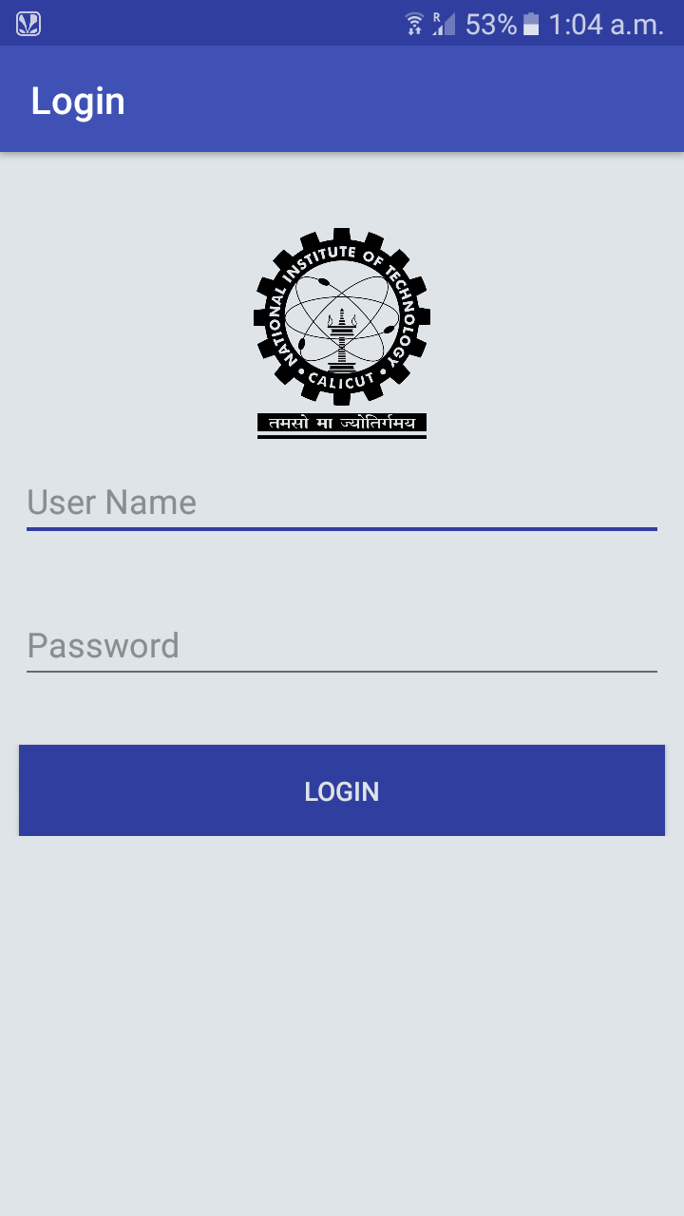
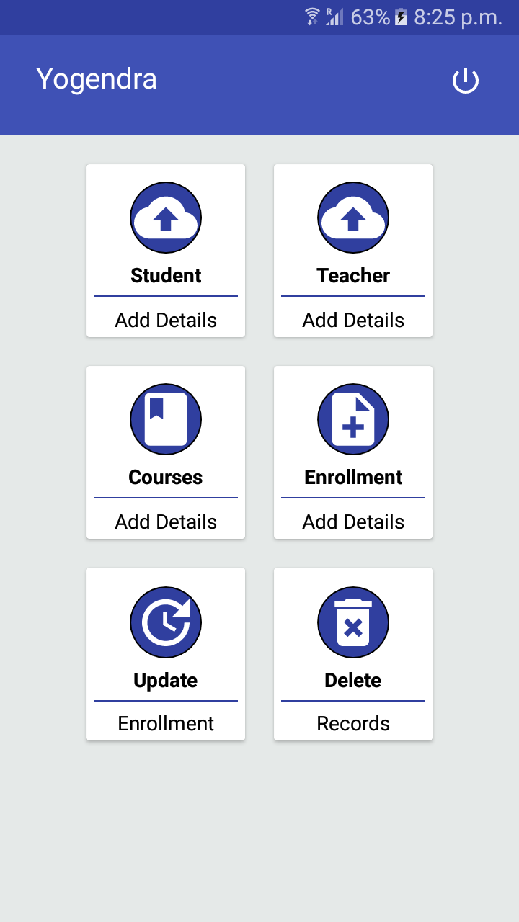
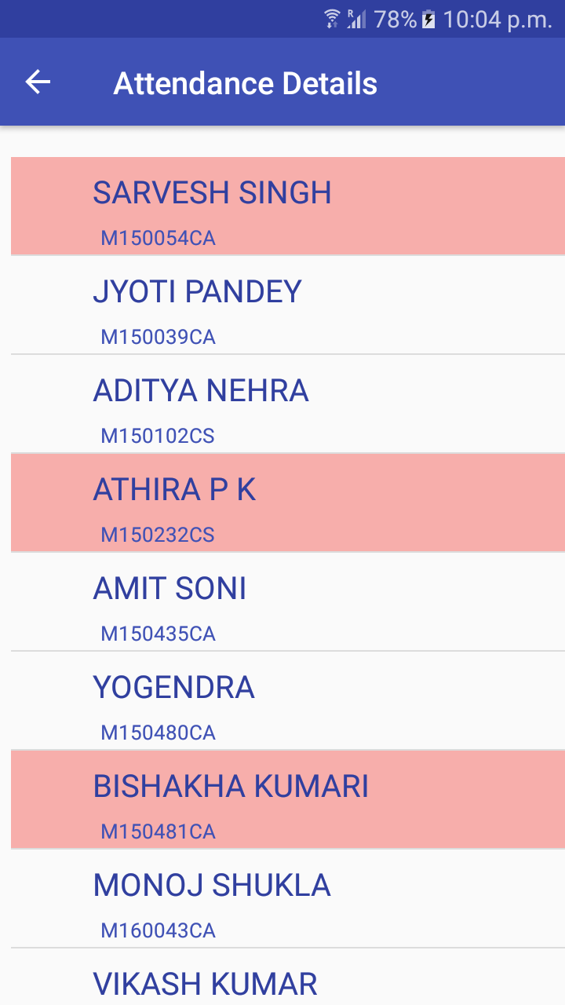
Demo Screenshots

Slide 11
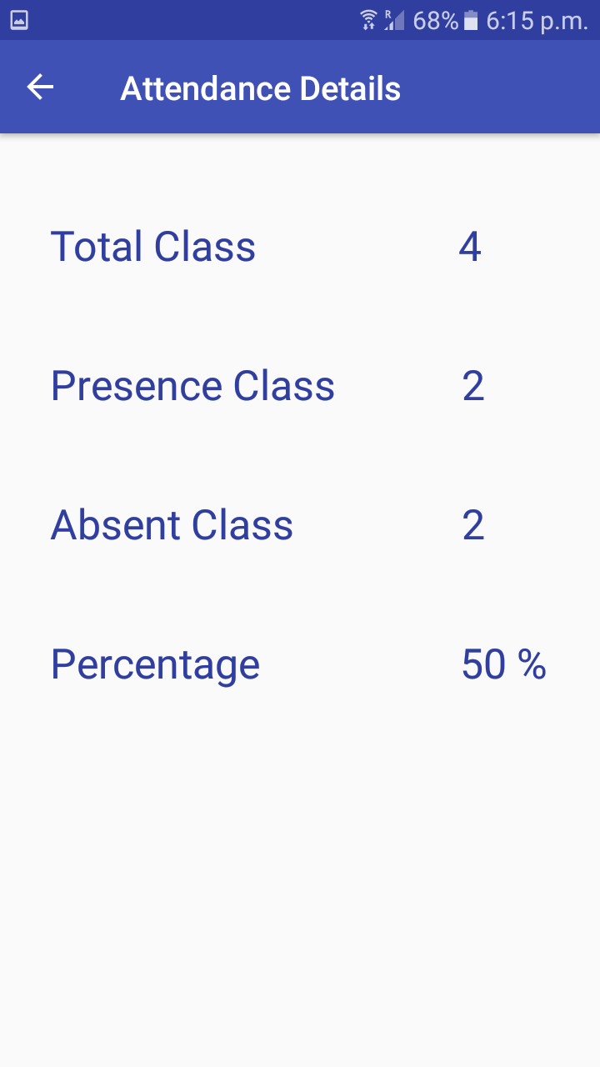
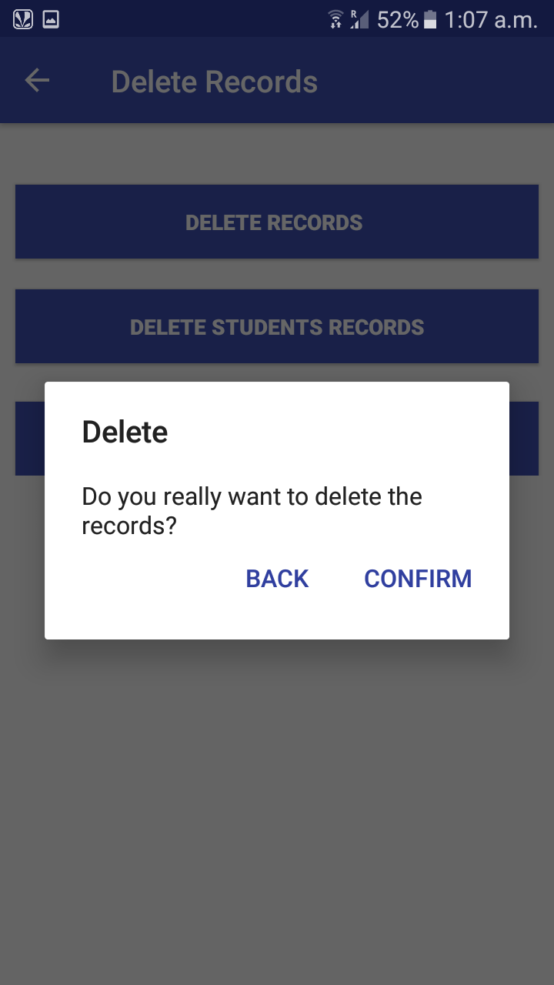
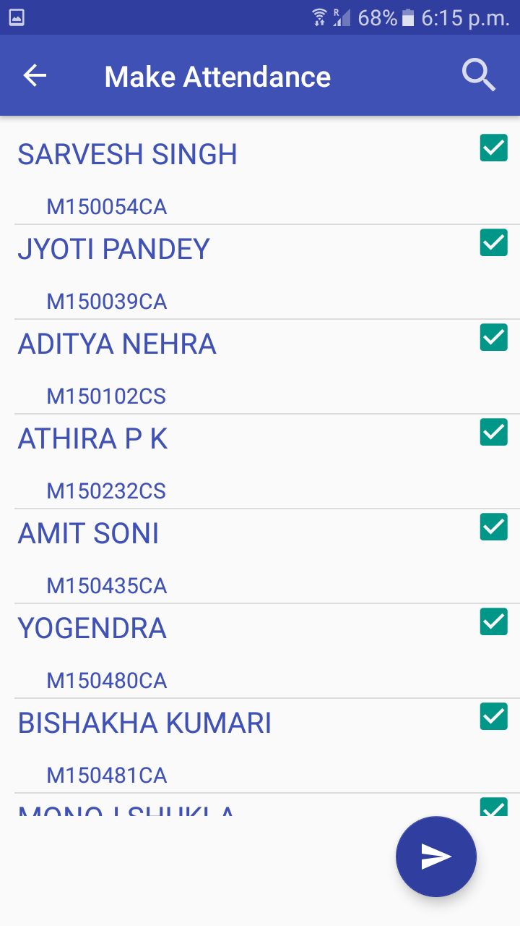

Slide 12
CONCLUSION
Attendance Management System (AMS) application i-Turnout has been developed for taking attendance and managing the associated activities. It helps Teacher in taking attendance, managing attendance related records and replying to students queries. Student can also be aware of their attendance , get notifications for short attendance and ask queries for any attendance issues. So it makes the task of both Teacher and Student easier , efficient and more accurate. This android application makes the attendance management inexpensive and environment friendly

Slide 13
REFERENCES
[1] https://www.udemy.com/complete-android-n-developer-course/ ‘Working of Android’ 05/05/2018
[3] https://www.w3schools.com/php/php_mysql_intro.asp 08/05/2018
[4] Ramez Elmasri, Shamkant B. Navathe: Database Systems: models, languages, design and application programming, Pearson, Edition
[6] https://www.youtube.com/results?search_query=android+studio+by+prabeesh 01/05/2018
[7] https://in.udacity.com/course/android-developer-nanodegree-by-google--nd801 14/04/2018
[8] https://creately.com/app/# 18/05/2018

Slide 14
Thank You

